Slide 1

Problems on Conditional Probability 2011

Slide 2
Reference
Data
Youtube
Code

Slide 3
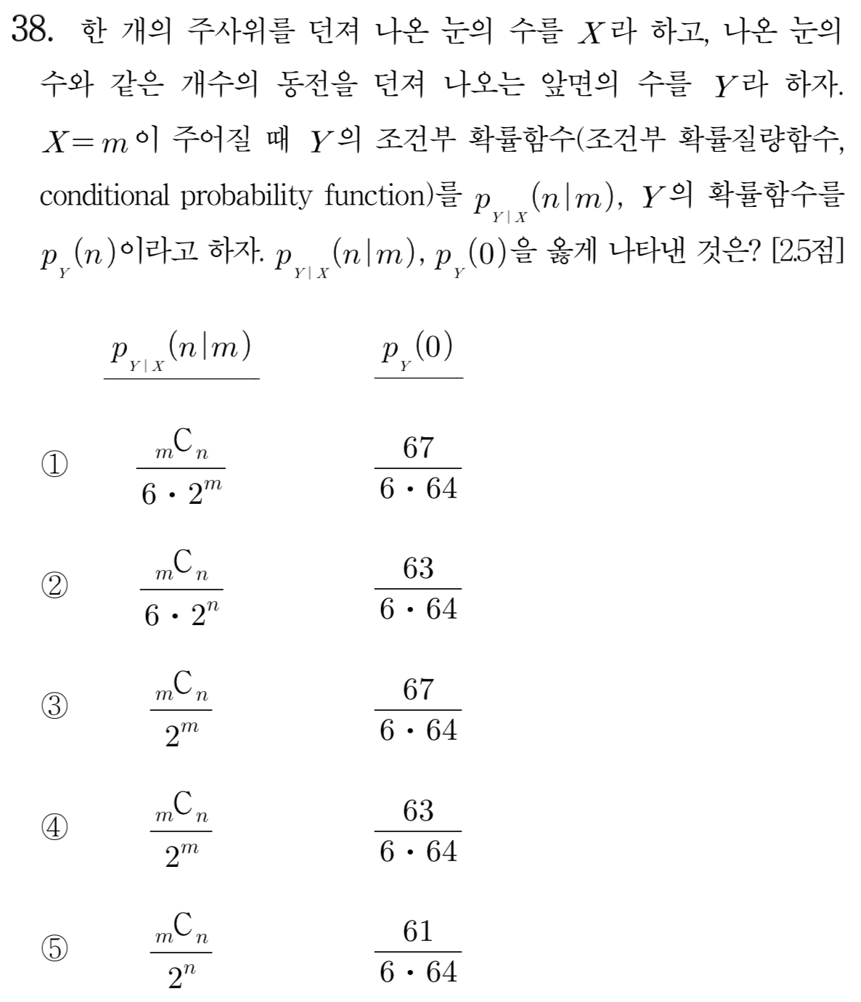
[2011]

Slide 4
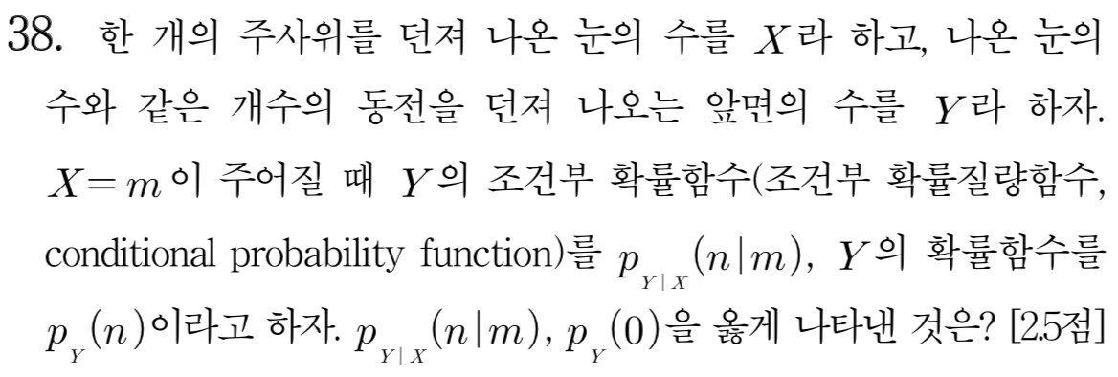

Slide 5
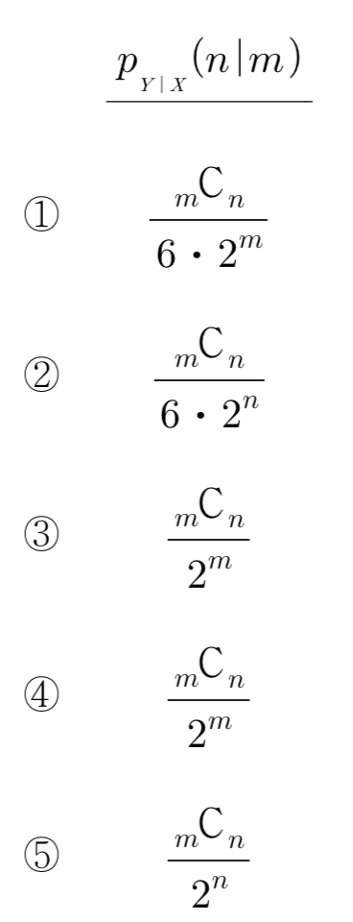

Slide 7
